Slide 1


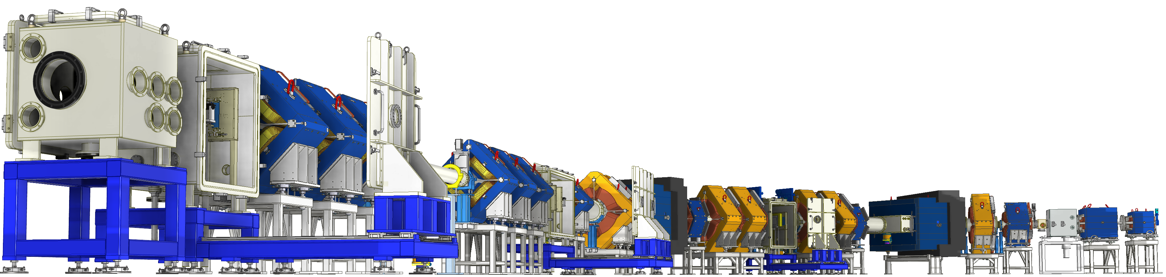

Slide 2
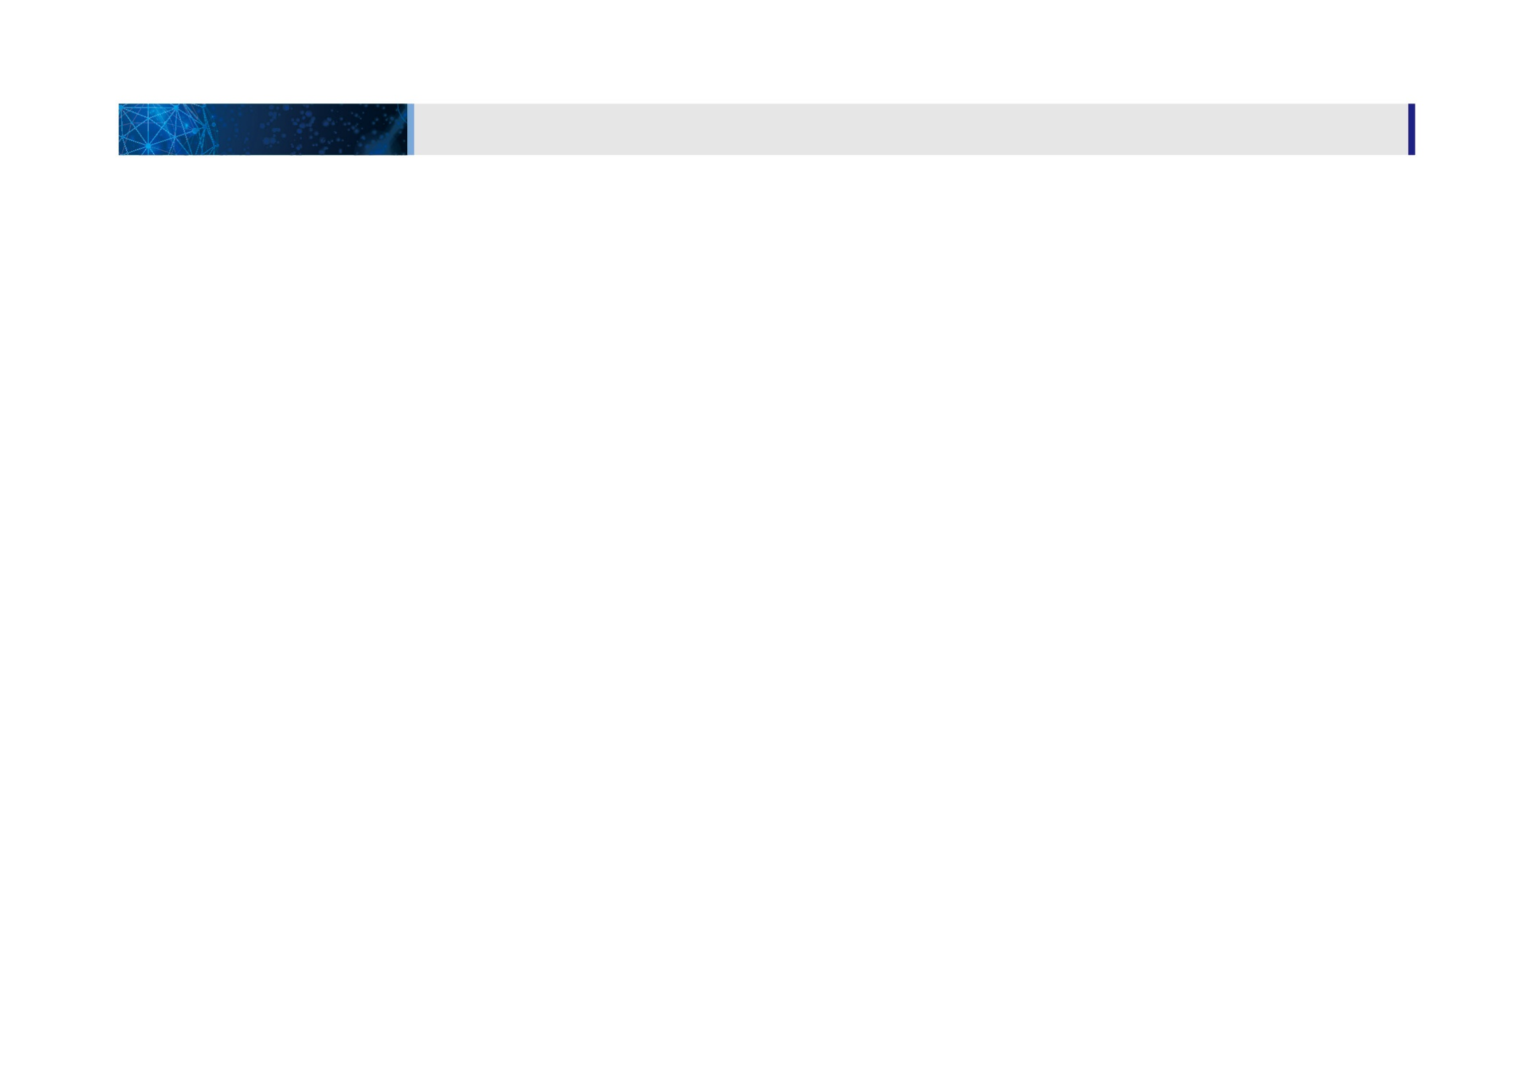
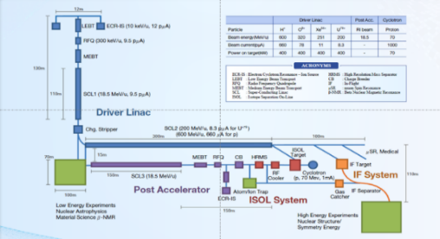
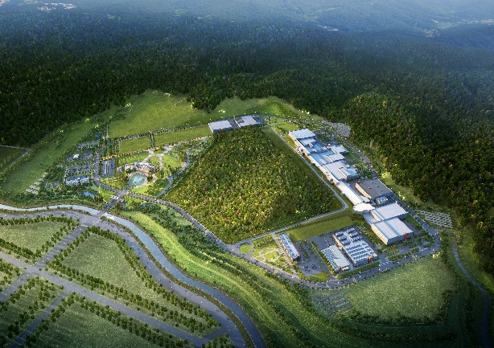
Rare Isotope Science Project (RISP)
1. Overview
Goal: To build a heavy ion accelerator complex RAON,
for rare isotope science research in Korea.
* RAON - Rare isotope Accelerator complex for ON-line experiments
Budget: KRW 1,498 billion (US$ 1.23 billion, 1$=1,209krw)
- accelerators and experimental apparatus : 502.8 billion won
- civil engineering & conventional facilities : 996 billion won (incl. site 357 billion won)
Period: 2011.12 ~ 2021.12
System Installation Project
Providing high intensity RI beams by ISOL and IF
ISOL: direct fission of ²³⁸U by 70 MeV proton
IF: 200 MeV/u ²³⁸U (intensity: 8.3 pμA)
Providing high quality neutron-rich beams
e.g., ¹³²Sn with up to 250 MeV/u,
up to 10⁹ particles per second
Providing More exotic RI beam
production by combination of ISOL and IF
Development, installation, and commissioning of the accelerator systems that provides high-energy (200MeV/u) and high-power (400kW) heavy-ion beam
Facility Construction Project
Construction of research and support facility to ensure the stable operation of the heavy-ion accelerator, experiment systems, and to establish a comfortable research environment
※ Accelerator and experiment buildings, support facility, administrative buildings, and guest house, etc.

Slide 3
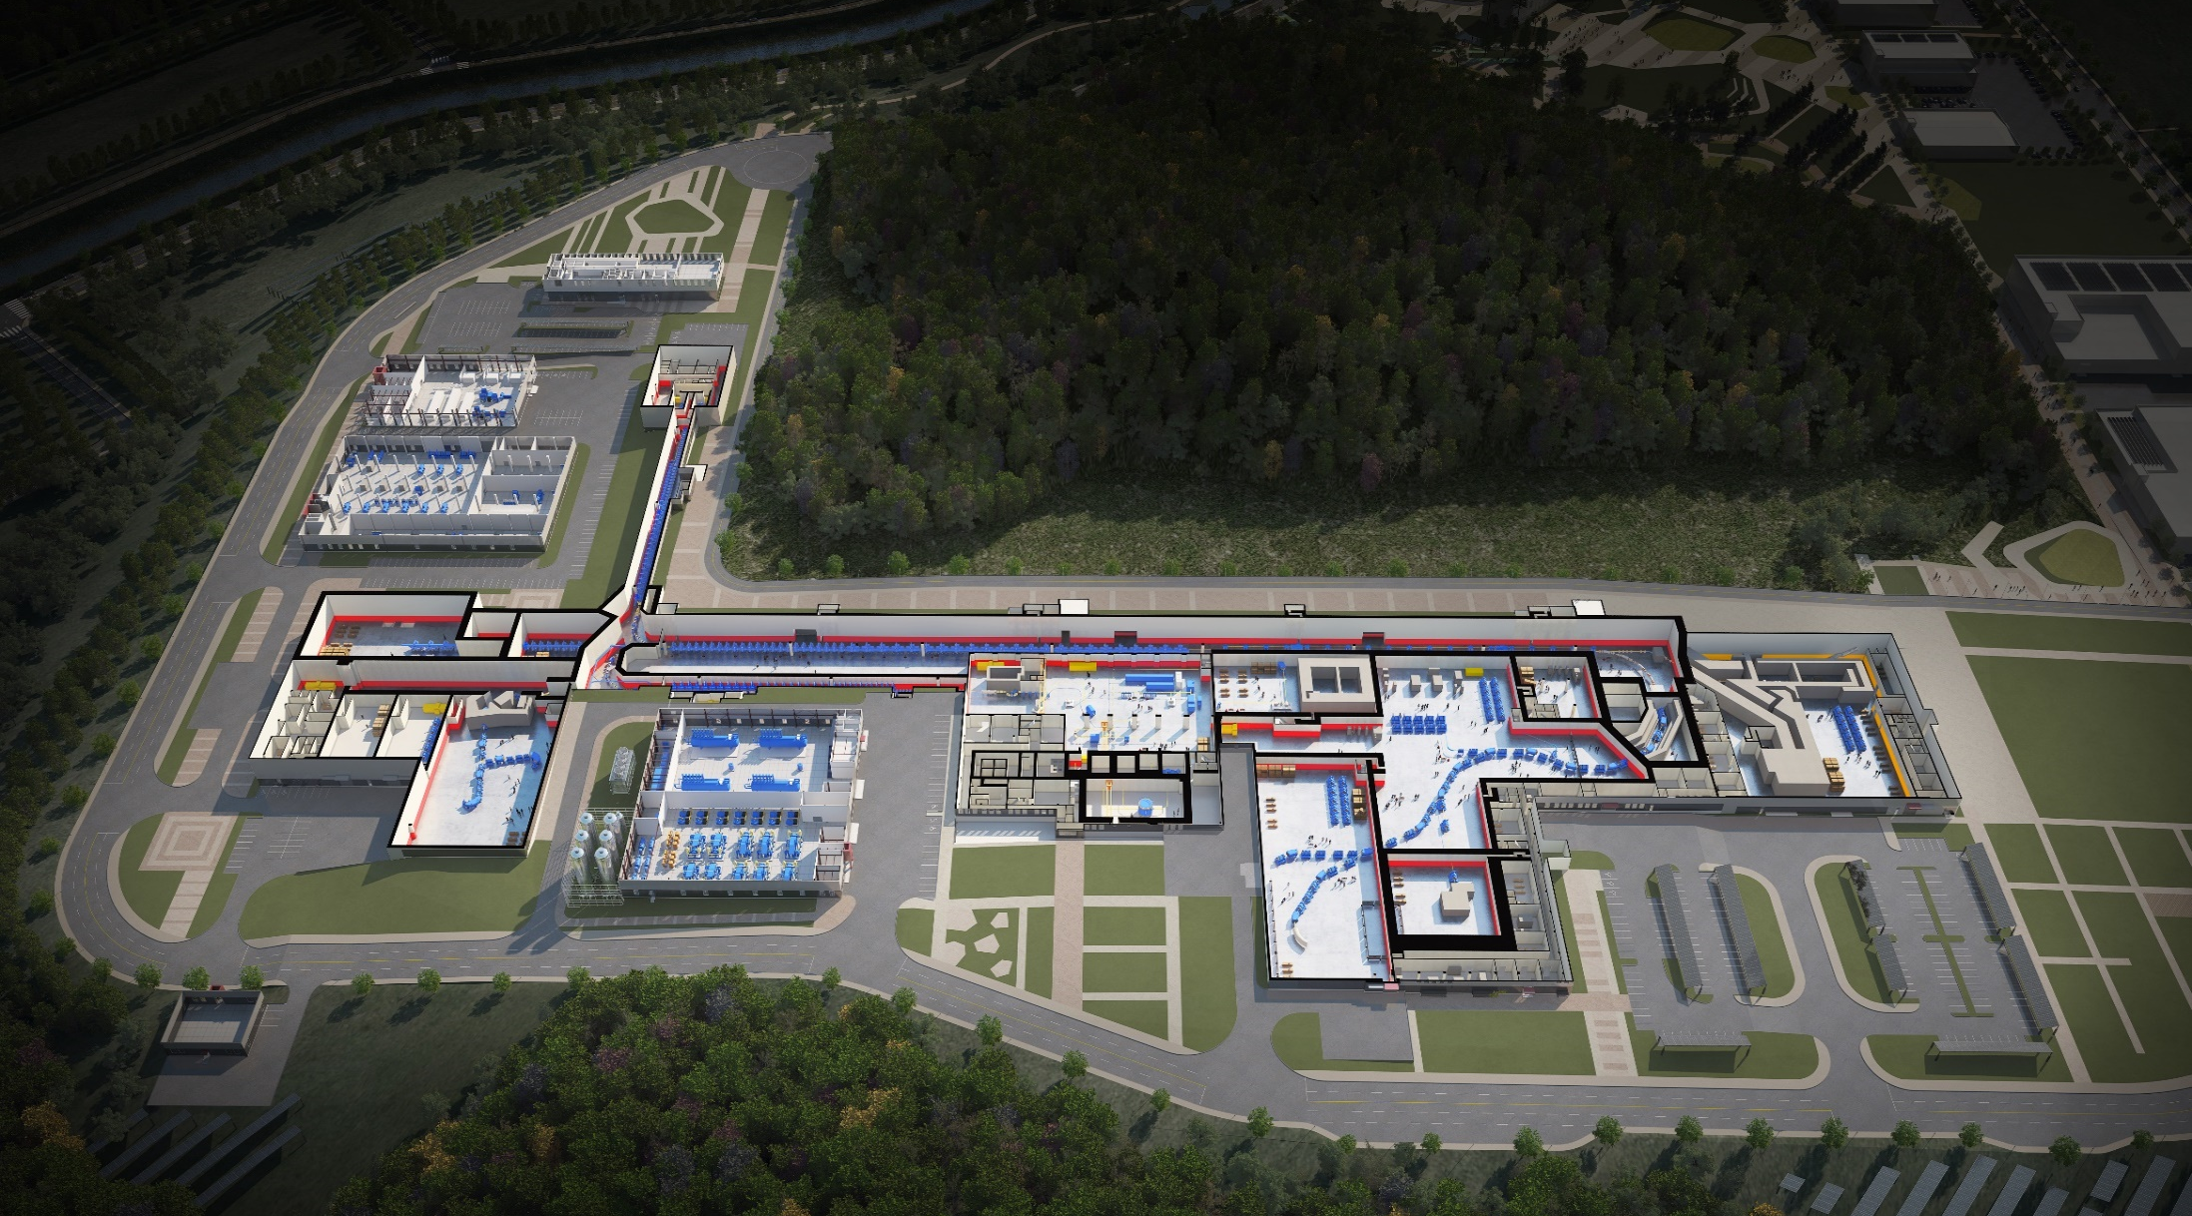

RAON Layout
1. Overview
Control
Center
Utility
SCL1
ISOL System
HPMMS/
CLS
IF System
SCL3
SCL2
BIS
ECR IS
μSR
NDPS
KOBRA
Cyclotron
HRS
LAMPS
SCL1 has been decided to postpone
: SCL3 is going to be taking a role of SCL1 in the early operation

Slide 4
1. Overview
RIBs at RAON
IF
ISOL
KOBRA
ISOL+IF
RAON will provide access to unexplored regions of the nuclear chart

Slide 5
1. Overview
Project History
System Installation
Facility Construction
Project General
Jan 2012 Established Master Plan for RISP
June 2012 Submitted Basic Design Summary
(BDS)
May 2014 Finalized the Master Plan for the
Establishment of the IBS
(Heavy-ion Accelerator)
July 2014 Finalized the Implementation Plan
for the Construction of the
Heavy-ion Accelerator Facility
Dec 2014 Began the basic design of facility
construction
June 2016 Constructed the
SRF test facility
at Munji
Sep 2016 Started detail design
of facility construction
March 2018
Completed
the SCL3 HWR
prototype module
performance test
2012
2013
2014
2015
2016
2017
2018
2019
Jan 2009
Finalized the Comprehensive
Belt Plan (National Science &
Technology Commission)
June 2010
Completed the research to
establish the Heavy-ion
Accelerator Construction Plan
Feb 2011
Completed the Heavy-ion
Accelerator Conceptual Design
Dec 2011
Launched the Heavy-in
Accelerator Project
June 2013 Completed Technical Design
Report (TDR)
Sep 2013 Revised the Master Plan (1st)
(period extension (~2019),
implementation schedule
change, etc.)
April 2015 Revised the Master Plan (2nd)
(period extension (~2021),
implementation strategy
change, etc.)
Dec 2015 Completed the basic design
of facility construction
Feb 2017 Began the priority work of
facility construction
May 2017 Successfully completed
the performance test of the
SCL3 QWR module
June 2017 Completed the detail
design of facility
construction
Sep 2017 Began the facility
construction
Oct 2017 Successfully completed the
SCL demo runs
Dec 2017 Project review by TF
May 2019 Revised the Master Plan (3rd)
(scope and strategy change)
Sep 2019
Install the first QWR module

Slide 6
1. Overview
Project Milestone
(2018)
SCL3 manufacturing
SCL2 Prototype
(2019)
SCL3 Installation
SCL2 manufacturing
(2020)
SCL3 Beam Commissioning/
Const. Completion
(2021)
KOBRA operation/
Project Completion
System Installation
ECR-IS beam &
ISOL beam (SI beam)
(Dec 2015)
18.5MeV/u
SI beam
(Dec 2020)
18.5MeV/u
RI beam
(Sep 2021)
SCL demo beam
(Dec 2017)
2014
2015
2016
2017
2018
2019
2020
2021
RFQ beam
(Dec 2016)
SCL
installation
(April 2019)
ISOL
Commissioning
(July 2020)
D-1
Experiment
(Jan 2021)
SCL2
(Dec 2021)
Facility Construction
Completion of basic design
(Dec 2015)
Completion of detail design
(June 2017)
Supply of utilities
(Dec 2018)
Building
Permit
(April 2021)
2014
2015
2016
2017
2018
2019
2020
2021
Beginning of priority
construction
(Feb 2017)
Beginning of construction
(Sep 2017)
Completion of construction
(Dec 2020)
Completion of inspection of the radiation facility
(Dec 2021)

Slide 7

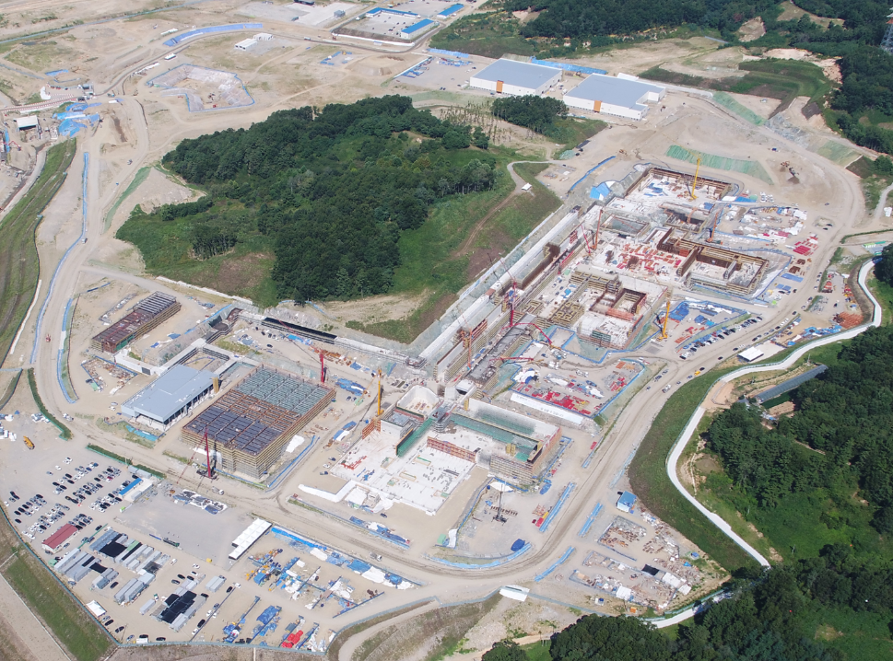
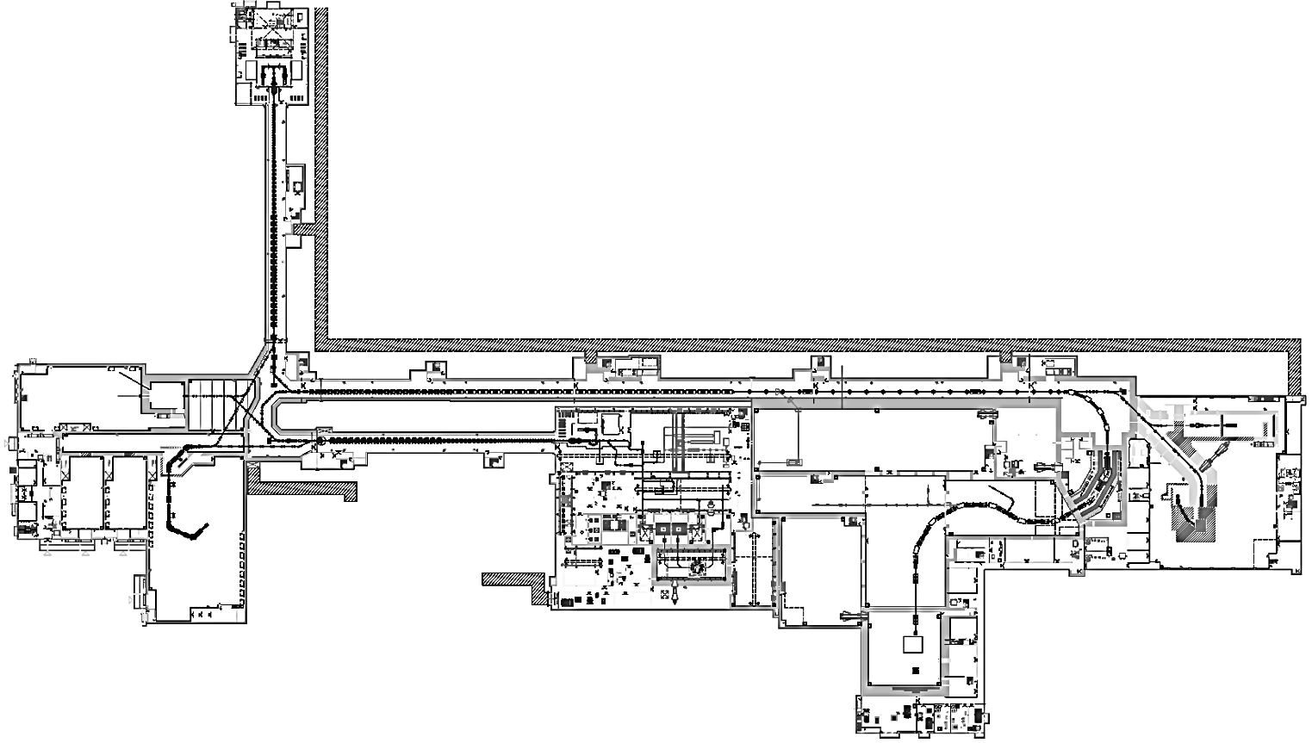
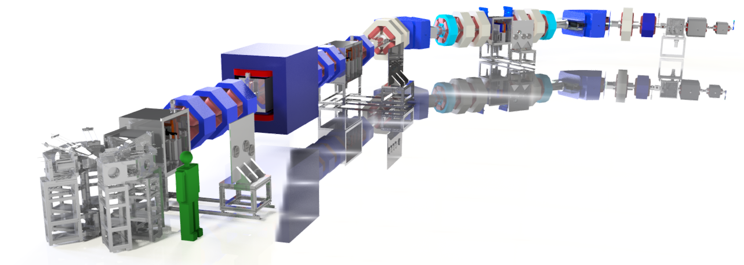
Korea Broad acceptance Recoil spectrometer and Apparatus
Goal: Construction of multi-purpose experimental instrument using stable or RI beams for studies of the nuclear structure and nuclear astrophysics, in the energy range of about 1 – 30 MeV/u
RI beam productions at a few MeV/u and at about 20 – 40 MeV/u using a stable beams from ECR ion source
Recoil mass separator at less than few MeV/u for direct measurements of radiative-capture cross, using a RI beams from ISOL facility
2018.08
SCL1
Low energy experimental hall B
SCL2
SCL3
Spallation room for future extension
Ions are accelerated
up to about 40 MeV/u for A < 40, up to about 20 MeV/u for A > 100
IF facility
High energy experimental hall B
Low energy experimental hall A
ISOL facility
High energy experimental hall A
KoBRA

Slide 8
Basics of RI production: 희귀동위원소(RI) 빔 생성 (in-flight method)
가속관
이온원 (ion source)
전자석
+
+
+
+
+
이온화
가스 또는 금속 샘플 주입
(안정 원소: 안정한 원자핵)
입사빔 (1차 빔, Primary beam or Projectile)
+
생성 표적 (production target)
Projectile-like fragmentation
+
+
Excited projectile-like fragment
+
표적과 반응하여 생성된 희귀동위원소 (RI)
(2차 빔: Secondary beam or fragments)
Projectile
fragmentation
Target
De-excitation of fragment
반응하지 않고 지나가는 1차 빔

Slide 9
Basics of RI production: 희귀동위원소(RI) 빔 생성 (in-flight method)
가속관
이원온(ion source)
전자석
+
+
+
+
+
이온화
가스 또는 금속 샘플 주입
(안정 원소: 안정한 원자핵)
입사빔 (1차 빔, Primary beam or Projectile)
+
생성 표적 (production target)
원하는 희귀동위원소를 어떻게 식별하고 (분리하여) 빔으로 사용할 것인가?
+
+
+
표적과 반응하여 생성된 희귀동위원소 (RI)
(2차 빔: Secondary beam or fragments)
반응하지 않고 지나가는 1차 빔

Slide 10
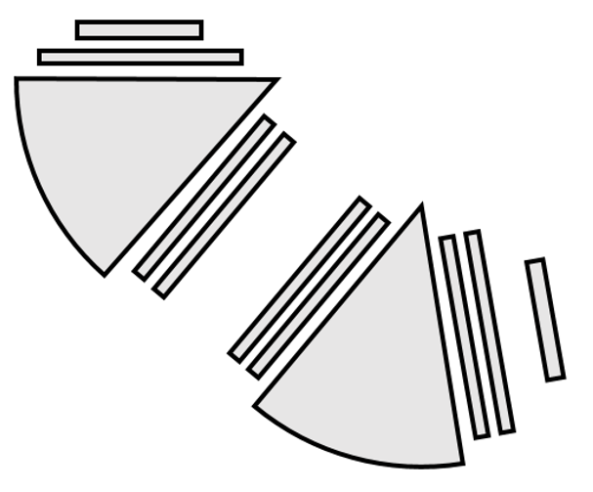
Basics of Separator : 2차 빔 분리 장치 (Separator)
Primary beam
Momentum dispersive focal plane
Production target
Beam dump
Lorentz force: F = qvB
Centripetal force: F = mv²/ρ
mv/q = Bρ ~ horizontal position
Momentum dispersive focal plane
Slit
Bending magnet
RI beam
Achromatic focal plane
Slit
Achromatic focal plane
Velocity v = Flight length / TOF
Nuclear charge Z ~ ΔE^{1/2} v
Position measurement
Bending magnet
Energy loss/Time-of-flight measurements
Position measurement → determine mv/q
Position and TOF measurements → determine A/q
Energy loss/Time-of-flight measurements → determine Z
Bρ- ΔE-TOF method

Slide 11
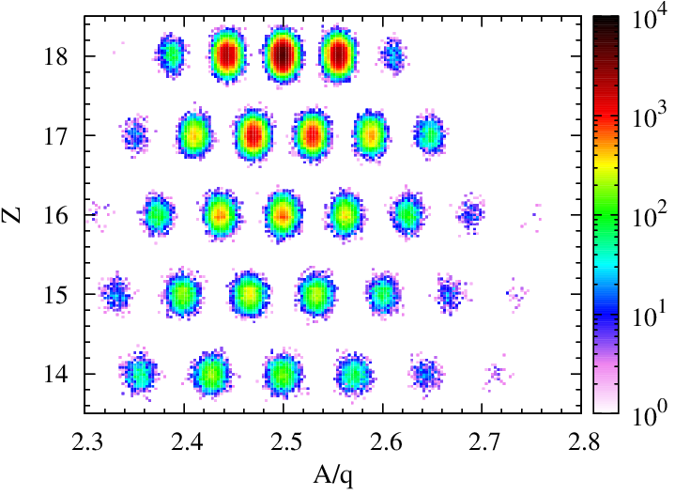
Basics of Seperator : 2차 빔 분리 장치 (Separator)
Primary beam
Momentum dispersive focal plane
Production target
Beam dump
Lorentz force: F = qvB
Centripetal force: F = mv²/ρ²
mv/q = Bρ ~ horizontal position
Momentum dispersive focal plane
Slit
Bending magnet
RI beam
Achromatic focal plane
Slit
Achromatic focal plane
Velocity v = Flight length / TOF
Nuclear charge Z ~ ΔE^{1/2} v
Position measurement
Bending magnet
Energy loss/Time-of-flight measurements
Position measurement → determine mv/q
Position and TOF measurements → determine A/q
Energy loss/Time-of-flight measurements → determine Z
Bρ- ΔE-TOF method

Slide 12
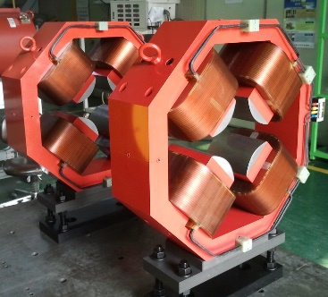
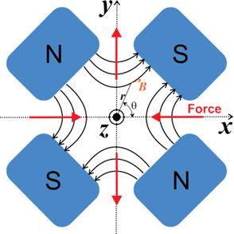
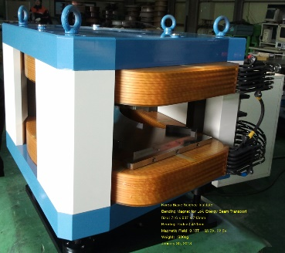
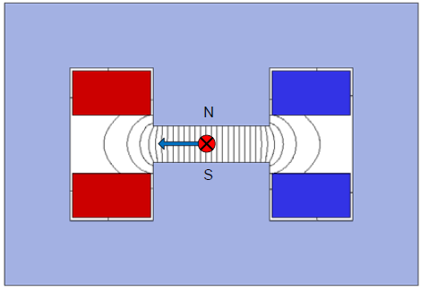
4극 2극 전자석
Quadrupole Magnet: 4극 전자석
Example
B = 0 for center
Ion beam
From KR tech
Horizontally focused
Vertically defocused
Horizontally defocused (weak)
Vertically focused (strong)
Example
Bending magnet (dipole magnet: 2극 전자석)
Low momentum ion
High momentum ion
Ion beam
N
Including momentum spread
S
This horizontal size corresponds to the momentum dispersion.
From KR tech

Slide 13
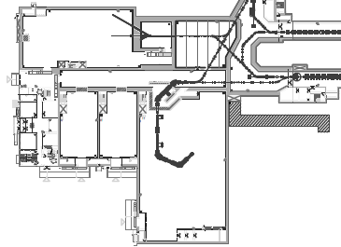
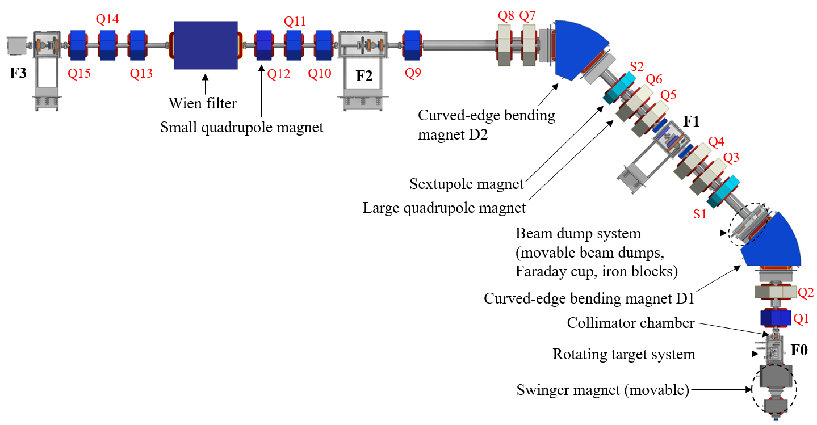
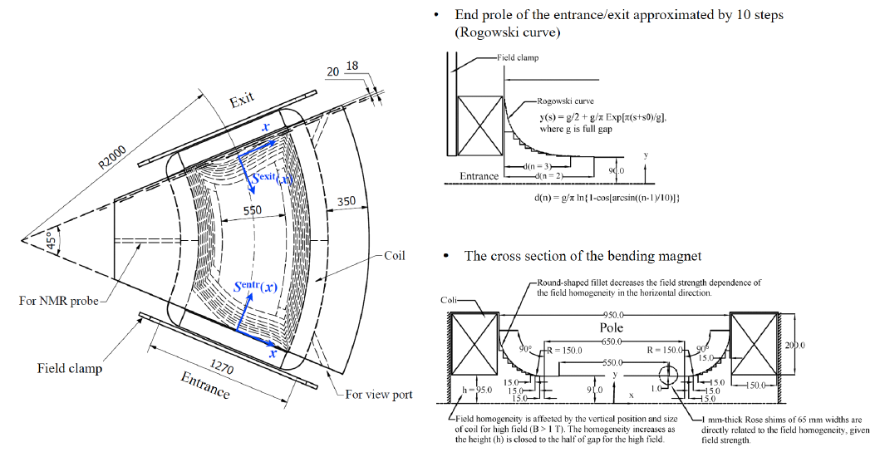
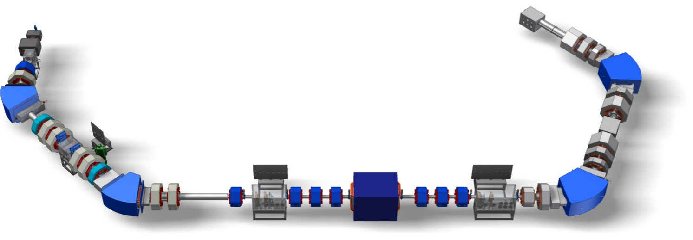
Korea Broad acceptance Recoil spectrometer and Apparatus
SCL2
SCL3
Future plan
Stage2
(Future extension)
Curved edge bending magnet
KoBRA Stage1
Stage1
Stage1:
RI beam productions at a few MeV/u or at about 20 – 40 MeV/u using a stable beams for study of nuclear astrophysics and nuclear structure
Recoil mass separator (with Stage2) at about less than few MeV/u for direct measurements of radiative-capture cross sections
Stage2 (Future extension, Detailed concept is under discussion with RAON Users Association):
High resolution separator (where Stage1 is used as a dispersion matching section)
Recoil mass separator (with Stage1) at about less than few MeV/u for direct measurements of radiative-capture cross sections

Slide 14
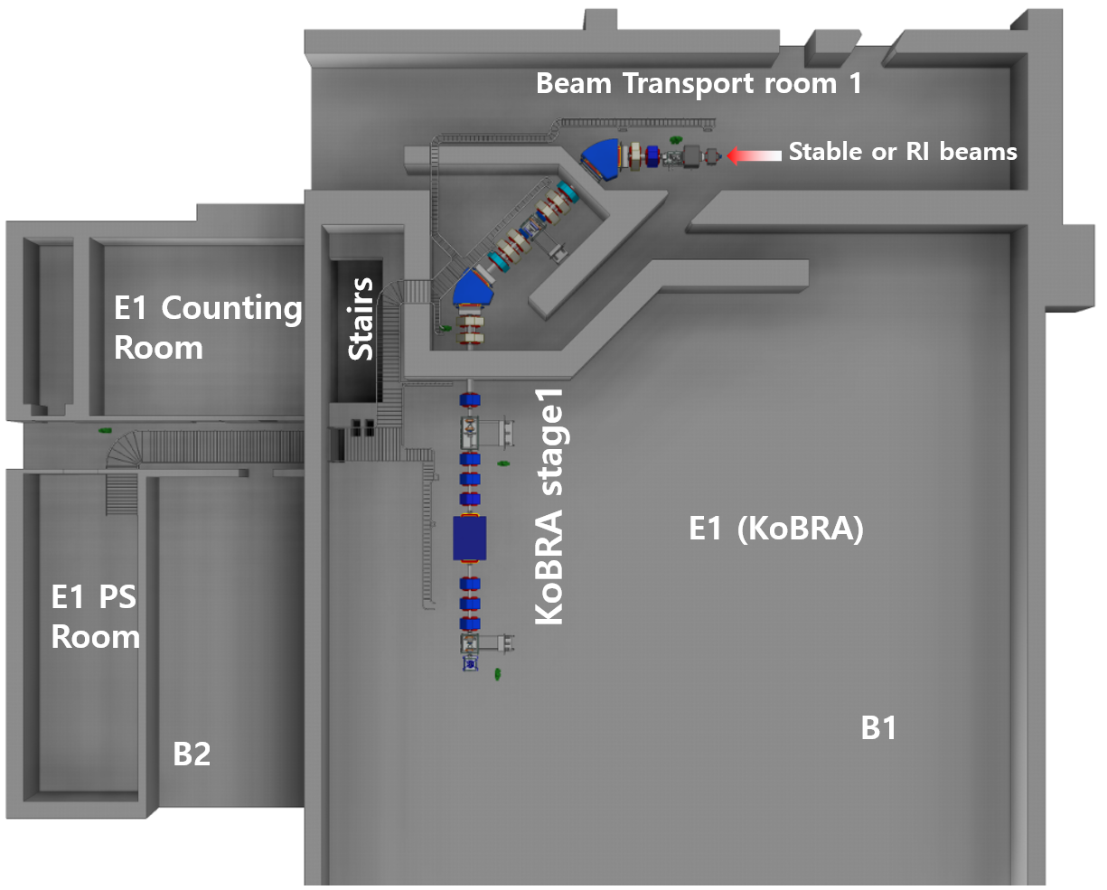
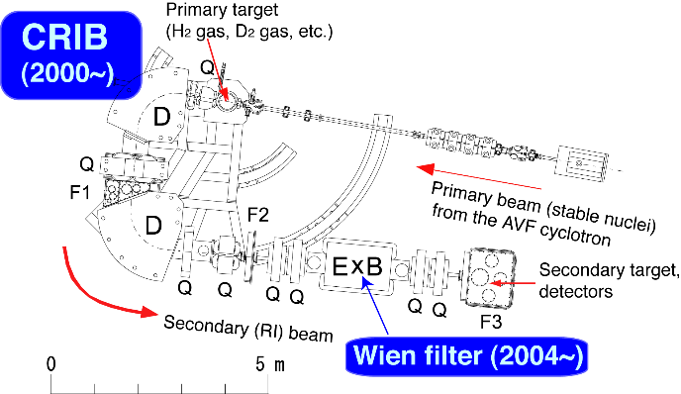
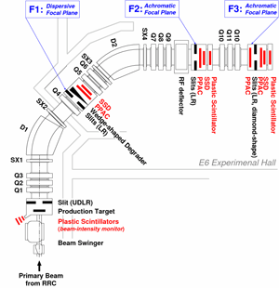
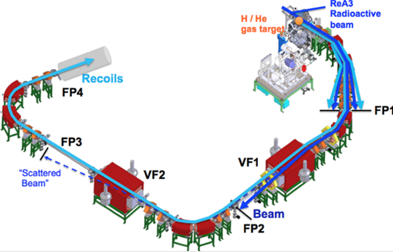
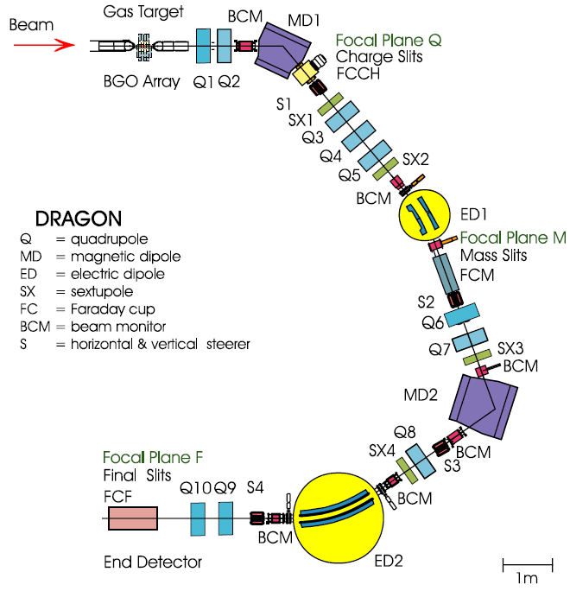
Korea Broad acceptance Recoil spectrometer and Apparatus
CRIB/CNS
RIPS/RIKEN
RI beam production for study of nuclear astrophysics in the energy of few MeV/u like CRIB.
RI beam production for studies of nuclear structure & nuclear reaction in the energy of 20 – 40 MeV/u for A < about 40 like RIPS.
Specification of KoBRA stage1
Magnetic rigidity | 0.25 – 3.0 Tm
Angular acceptance | 80 mrad (H) 200 mrad (V)
Momentum acceptance | 8%
Momentum resolving power at F1 | 2100 at 2 mm beam size
Mass resolving power (with Wien filter) | 1000 at 2 mm beam size
Beam swinger | up to 12 degree for 3 Tm
High order correction | up to 4th order
Degrader at F1 | Homogeneous
After adding Stage2,
RI Beams from ISOL facility
SECAR/MSU
TRIUMF
Recoil spectrometer for study of nuclear astrophysics in the energy of < few MeV/u like SECAR or DRAGON.

Slide 15
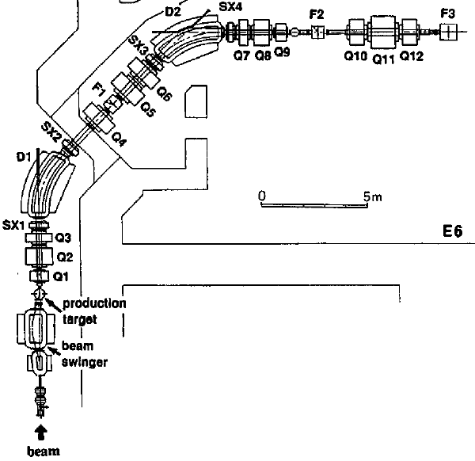
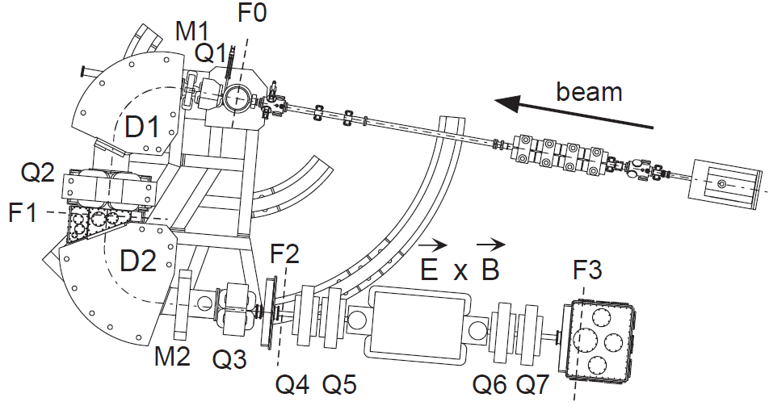
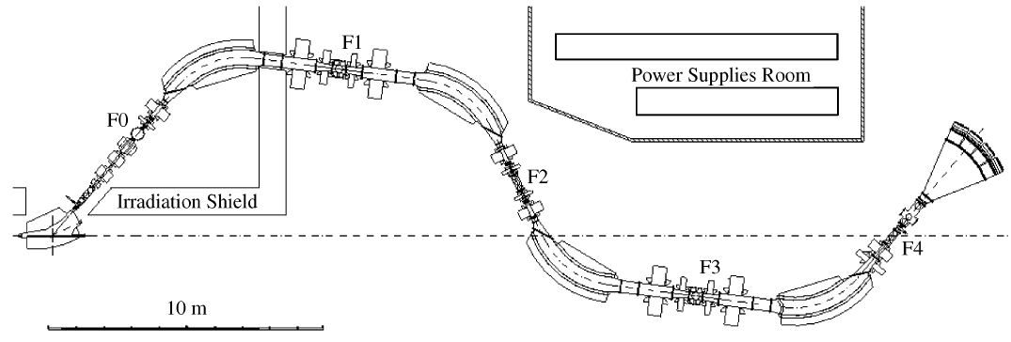
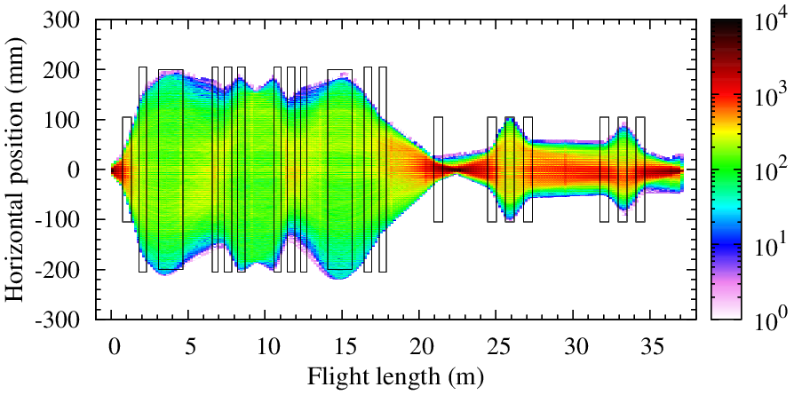
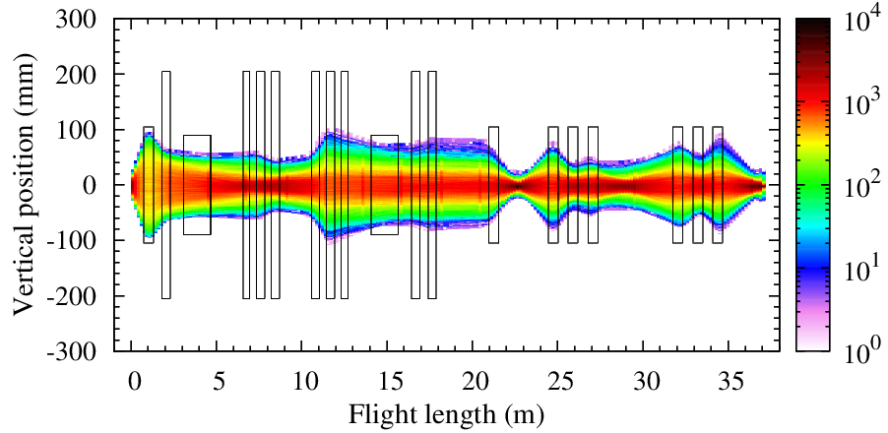
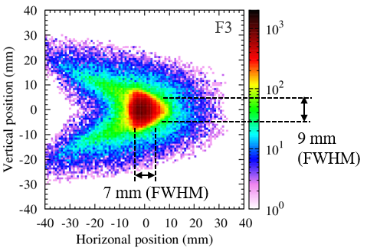
Specification comparison chart of RI beam Separators
 | RIBLL (HIRFL) | RIPS (RIKEN) | CRIB (CNS, University of Tokyo) | KoBRA stage1 (RAON)
Layout
Magnetic Rigidity | ≤ 4.2 Tm | ≤ 5.8 Tm | ≤ 1.3 Tm | 0.25 – 3.0 Tm
Separator Length | 35 m | 28 m | About 13 m | 38 m
Energy Acceptance | 20% | 12% | 30% | 16%
Angular Acceptance | 50 mrad | 80 mrad | 75 mrad | 80 mrad (H), 200 mrad (V)
Incl. Wien Filter | No | No | 1.5 m (50 kV/cm) | 2.5 m (27 kV/cm)
Beam Swinger | Up to 5° | Up to 15° | Rotatable separator (-5°−60°) | Up to ±12°
Z. Sun et al., NIM A 503 (2003) 496, T. Kubo et al., NIM B 70 (1992) 309, Y. Yanagisawa et al., NIM A 539 (2005) 74, K. Tshoo et al., NIM B 376 (2016) 188.
Secondary beam envelope of KoBRA stage1 & PID spectrum simulated
⁴⁸Ca beam (35 MeV/u), ⁹Be target
5th order ion optics
5th order ion optics

Slide 16

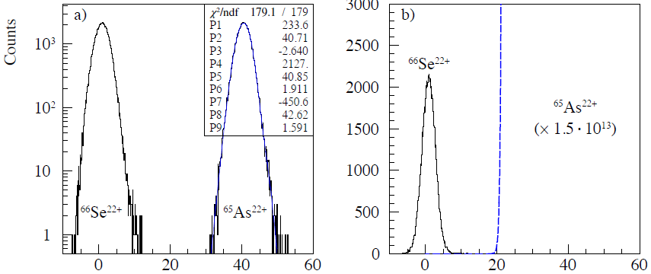
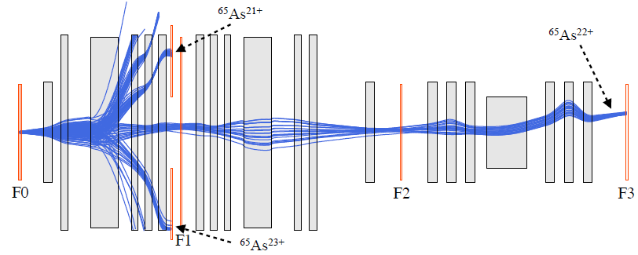
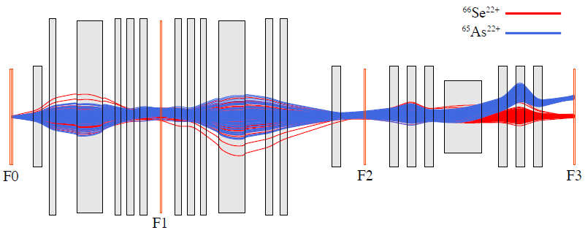
Specification comparison chart of recoil mass spectrometers
 | DRAGON (TRIUMF) | SECAR (MSU) | KoBRA stage1 (RAON) | KoBRA stage1 + stage2 (RAON)
Layout |  |  |  | Improve a mass resolution & primary beam rejection with cleanup section (Under Discussion)
Magnetic Rigidity | ≤ about 0.6 Tm | 0.14 − 0.8 Tm | 0.25 – 3.0 Tm
Max. Electric Rigidity | ≤ 8.0 MV | 1.0 − 19.0 MV | 2.0 − 18.5 MV
Spectrometer Length | 21 m | About 40 m | 38 m
Angular Acceptance | 40 mrad (H), 50 mrad (V) | 50 mrad | 80 mrad (H), 200 mrad (V)
Energy Acceptance | 10% | 6.2% | 16%
Mass Resolution | ≈ 350 | ≈ 750 | ≈ 650
Primary Beam Rejection | About 10⁻¹³ | 10⁻¹³ −10⁻¹⁴ | > ~10⁻¹³
D.A. Hutcheon et al., NIM A 498 (2003) 190, J.M. D’Auria, Nucl. Phys. A 701 (2002) 625c, G.P.A. Berg et al., NIM A 877 (2018) 87.
Simulated trajectories of primary bream and recoil product for KoBRA stage1
1.85 MeV/u ⁶⁵As (0.6 Tm) with H gas target
WF
WF
Charge selection
Mass selection
Position distribution at F3 (mm)

Slide 17
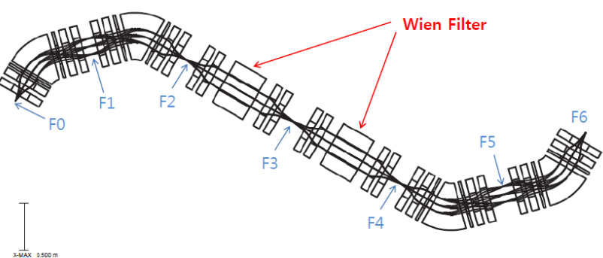
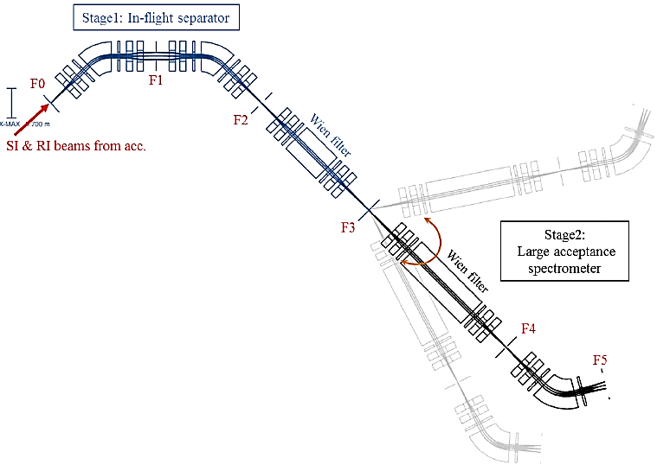
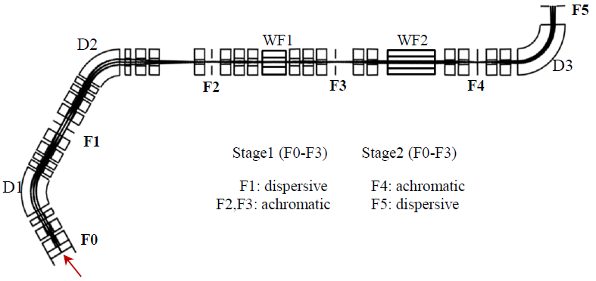
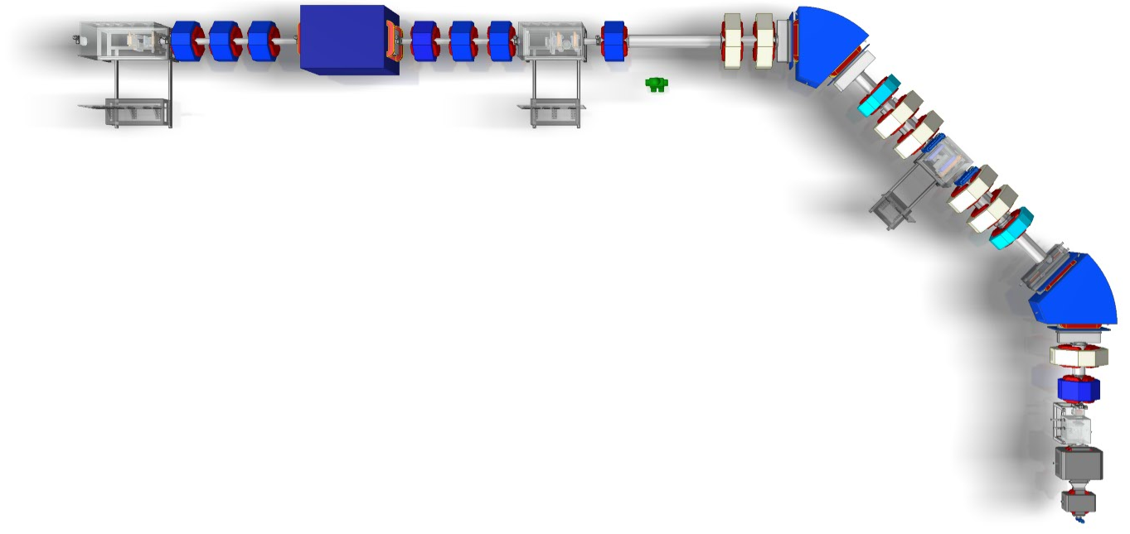
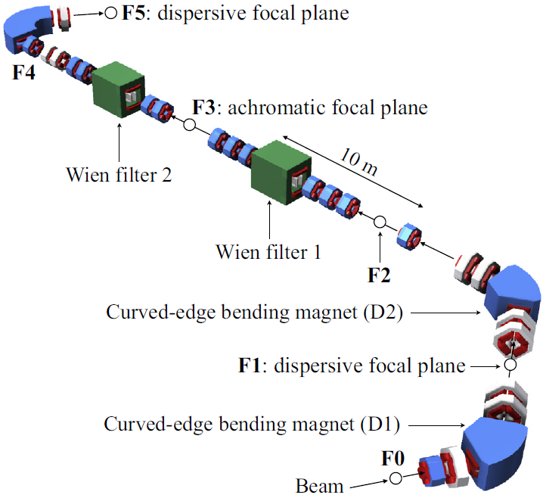
Design History of KoBRA
Year 2011.12
Year 2011.12 – 2012.06
Year 2012.07 – 2014.04
Rare Isotope Science Project (RISP) Launched
RI beam production at a few MeV/u
Recoil mass spectrometer
RI beam production at a few MeV/u
Recoil mass spectrometer
High resolution separation
Adding High resolution separator function
KoBRA was divided into two stages, stage1 and stage2
Adding multipole magnets
(6 sextupoles, 2 octupoles for stage1 )
Increasing Magnetic Rigidity
(1.5 Tm → 3 Tm)
Stage2
Year 2018.05 – present
Stage1
Now stage1 is being produced with international/domestic companies
Only optical design
Unrealistic multipole magnets
Unrealistic drift spaces
Only optical design
Unrealistic multipole magnets
Unrealistic drift spaces
Year 2017.05 – 2018.04
2018.05
2011.12
2012.06
2013.06
Year 2014.05 – 2015.02
Purchasing procedures
Bidding excluding Wien filter
RAON Users Association lunched
RISP lunched
Base line Design Summary
RI beam production at a few MeV/u
RI beam production at < 40 MeV/u
Recoil mass spectrometer
High resolution separation
Technical Design Report
2016.08
2015.08
2014.02
2nd KoBRA review meeting
KoBRA mini workshop
1st KoBRA review meeting
Year 2016.08 – 2017.04
Year 2015.03 – 2016.07
Only optical design
Unrealistic multipole magnets
Unrealistic drift spaces
Adding a Swinger magnets
Adding a two sextupoles
Redesigning bending magnet
Designing diagnostic chambers
Redesigning radiation shielding walls
Accommodating a space for concrete wall
Stage2 is under discussion
Adopting curved edge bending magnets
Removing all multipole magnets
Designing all of magnets
Reflecting the field maps of designed magnets
Stage1
Adding RI beam production at few tens MeV/u
Increasing angular acceptance
(40 mrad → > 80 mrad)
Decreasing energy acceptance
(20% → 16%)
Starting Magnet design
Realistic magnet design
Reasonable drift spaces
Comments from 2nd KoBRA Review Meeting were reflected
Final design of stage1
Realistic magnet design
Reasonable drift spaces

Slide 18
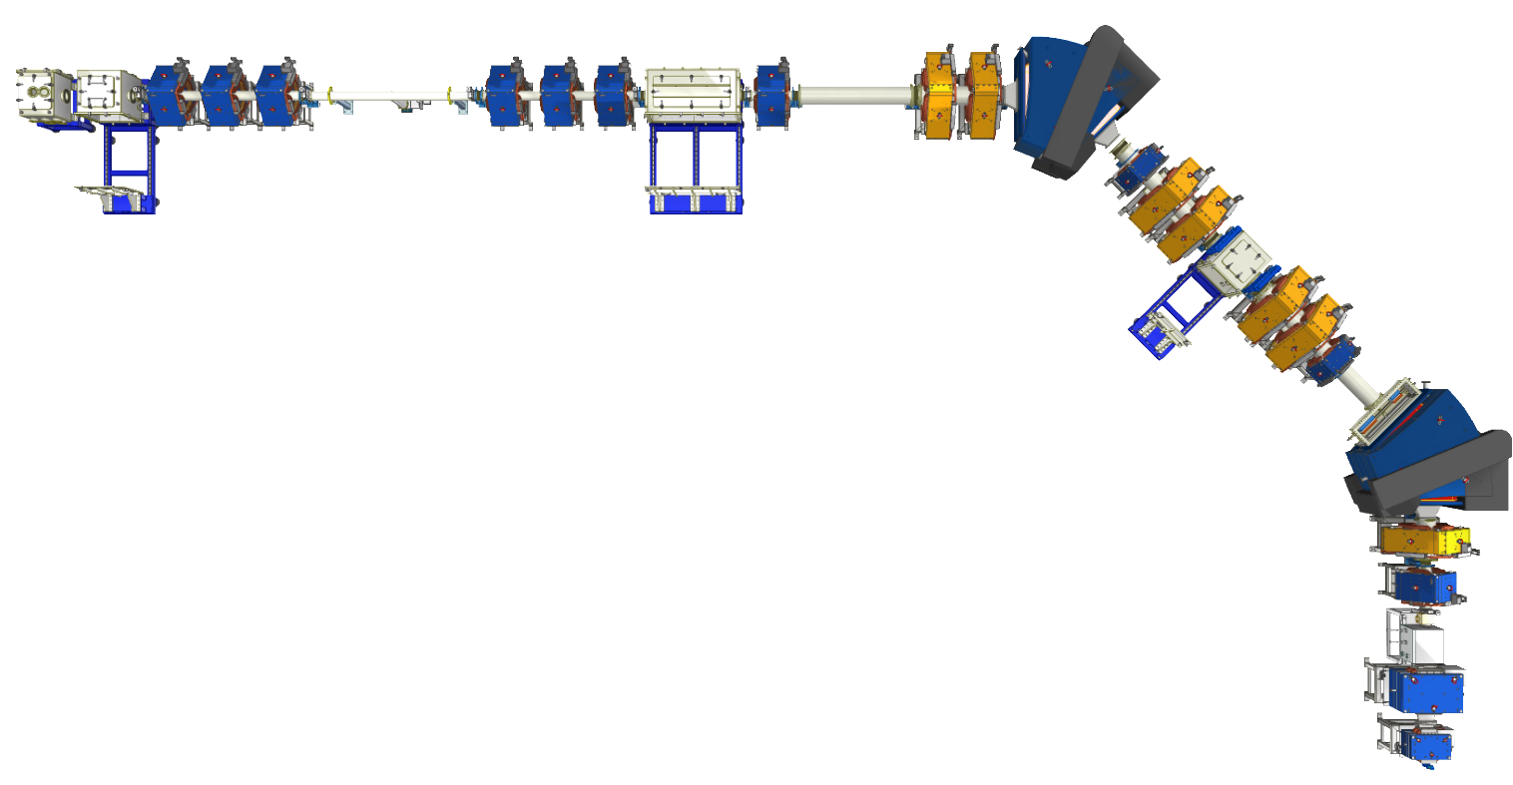
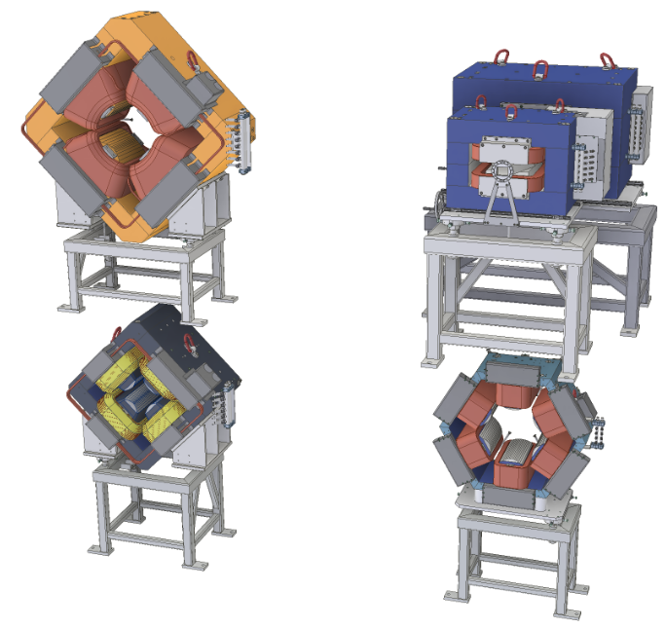

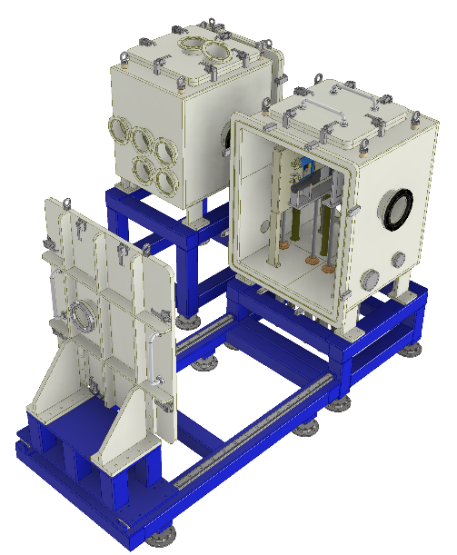

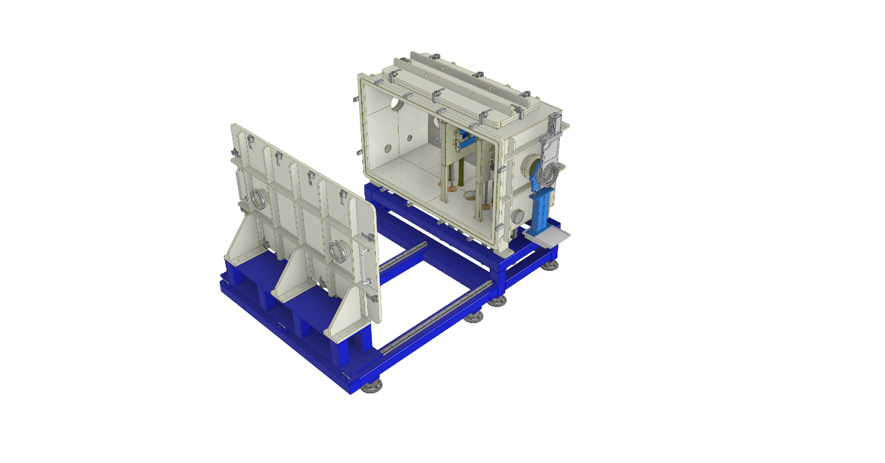
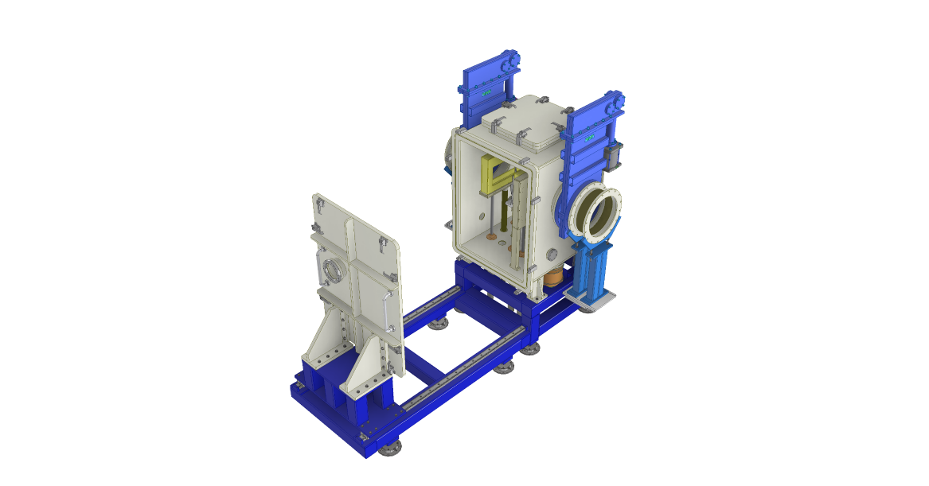


Present Status (Separator)
Large quadrupole magnet
Swinger
F3
5 m
F1
F2
Contracted on December 2018
Wien Filter will be added later due to the limitation of budget.
Contracted on April 2018
Small quadrupole magnet
Sextupole magnet
Consortium
F0
(Korea)
Project management
Removable scattering chamber
Empty space for Si-detector array
or IC chamber
(Danmark)
Project management
Designs of all magnets
Productions of bending magnets and swinger
(Korea)
Productions of quadrupole and sextupole magnets
(Korea)
Designs and productions of diagnostic chambers, beam pipe, beam dump, and etc
F3 chamber
F2 chamber
F1 chamber

Slide 19
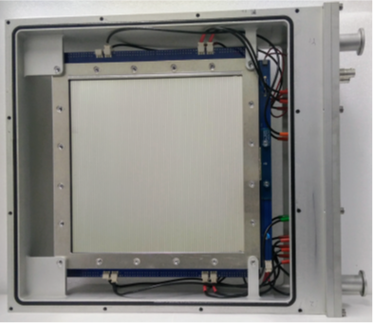
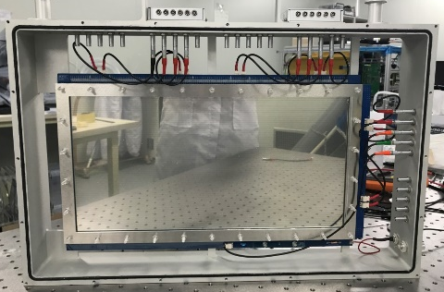
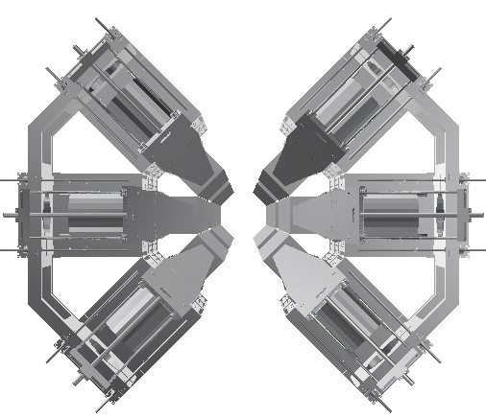
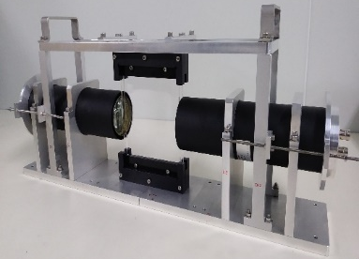
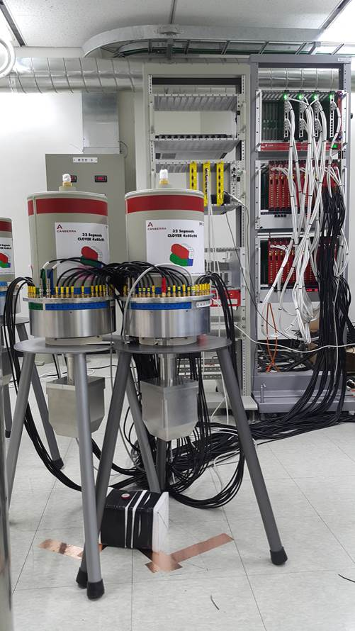
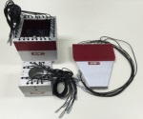
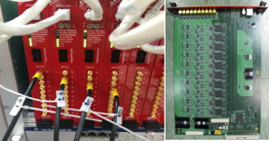
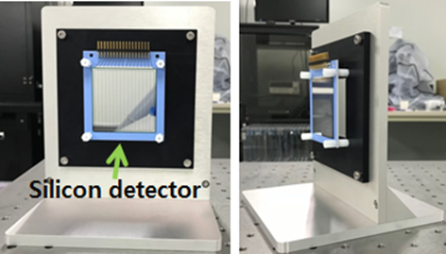
Present Status (Detectors)
PPACs
Plastic detector
PPACs
SSD
PPACs
We have six 10 x 10 cm², two 20 x 20 cm², two 40 x 20 cm² active area PPACs
Position resolution: < 1 mm in FWHM, (C₄H₁₀ gas, ¹⁶O beam at 2x10⁶ pps )
Large area PPACs
* Charles Akers et al., NIM A In Press, Accepted Manuscript (2018)
HPGe gamma array
Plastic scintillator detectors
We have one 10 x 10 cm² active area, 100 μm thick both side readout plastic detector
Time resolution < 42 ps for 5.486 MeV α in vacuum
One 10 x 10 cm² active area, 100 μm thick one side readout plastic will be produced
HPGe gamma ray detectors
32 segmented HPGe detectors (6set)
Compton suppressor BGO crystals (6set)
Complete set of TIGRESS electronics
SSD
We have two 5 x 5 cm² active area, 50 μm-thick, 16 channel SSD
Energy resolution ~ 0.7%, S/N ~ 272 for 5.486 MeV α in vacuum
All of detectors are fulfilled KoBRA detection system requirements.
Complete KOBRA detection system including spare detectors, Ion Chamber, HPGe gamma array and DAQ system will be ready by the middle of 2019.
4th RISP SPAC 1- 2 April 2019

Slide 20





Present Status (photos of Low Energy Experimental Hall)
Beam Transport Room 1
E1 (KoBRA)
SCL2 Tunnel
SCL3 Tunnel
SCL3
E1 (KoBRA)
15 March, 2019
E2
Low Energy Experimental Hall B (Neutron science)
E3
Low Energy Experimental Hall A
Low Energy Experimental Hall B (Neutron science)
12 March, 2019
15 March, 2019
The finishing materials of Low Energy Experimental Hall will be completed till the end of 2019.
Utility to supply electric power, cooling water, and air conditioning for Low Energy Experimental Hall A will be ready till the end of 2020.
4th RISP SPAC 1- 2 April 2019

Slide 21







Present Status (Separator)
Small quadrupole magnet 총 8기 저에너지실험동A에 입고 완료 (‘20.06.22)
Large quadrupole magnet 총 7기 공장검사 중 (‘20.07.15)
Curved edge bending magnet 총 2기 공장검사 (성능시험) 중 (‘20.07.15)
2020.04.
2020.04.
빔덤프 공장검사 완료 및 입고 준비 중 (‘20.07.15)
F3
F1
F2
F1/F2/F3 빔진담 진공챔버 공장검사 완료 및 입고준비 중 (‘20.07.15)
Sextupole magnet 총 2기 저에너지실험동A에 입고완료 (‘20.06.22)
F0
Swinger magnet 1 and 2 저에너지실험동A에 입고완료 (’20.05.08)
2020.04.
2020.01.

Slide 22








3. Sys. Install.
KOBRA
Water cooled Beam dump
Particle detector system
2020.04.
High power target (Prototype)
Water cooled collimator
2020.04.
2015
2020.04.
Installation test of radiation shielding blocks (Low Energy Experimental Hall A)
2020.04.03
2020.04.09
2020.04.20
• We plan to complete the installation of KoBRA till the end of this year, and to perform the commissioning with stable ion beams from the beginning of next year (2021).

Slide 23
Scientific program at early phase operation(candidate)
3. Sys. Install.
Facility | Subject for early phase operation
KOBRA | ∙ Transfer reaction measurements in inverse kinematics (²⁹P(d,p)³⁰P, ²⁶Al(α,p)²⁴Si) ∙ Radiative capture reactions using batch mode RI beams (^{26g}Al(p,γ)²⁷Si) ∙ RI beam production via quasi-projectile-like fragmentation for ¹⁶O or ⁴⁰Ar
LAMPS | ∙ Ar+KCl or Xe+CsI in case of IF separator commissioning not completed
MMS | ∙ Isomer separation with using ^{26g.s.}Al and ^{26m}Al beams
CLS | ∙ Laser ionization and measurement of isomeric property for ²⁶Al
NDPS | ∙ Activation experiments with a quasi mono energy neutrons for light and heavy nuclei ∙ Surrogate reactions for fission
μSR | ∙ One of research areas of superconductivity and quantum magnetism with their scientific significance at the time of the μSR instrument completion
BIS | ∙ Physical dose distribution and linear energy transfer measurements with a ¹²C⁺⁶ beam (310 MeV/u)

Slide 24




Physics topic (long term plan)
One of the major goals @ KoBRA: to understand the origin of the chemical elements (Nuclear Astrophysics)
• Direct measurements of charged-particle induced (p,γ) and (α,γ) radiative capture reactions
e.g. ⁶⁵As(p,γ)⁶⁶Se and ¹⁵O(α,γ)¹⁹Ne reactions at E_{beam} < ~ 1 MeV/nucleon
• Transfer reaction measurements for single-particle and single-hole state studies at the beam energy of about a few MeV/nucleon
• Measurements of excitation functions for astrophysically-important compound nucleus reactions such as (p,α) and (α,p)
• elastic & inelastic scattering measurements in inverse kinematics using ¹H and ⁴He targets
Constraining reaction rates over large temperature range is required!
Massive stars (WR, AGB)
T < 0.1 GK
Novae
T < 0.6 GK
Core-collapse supernovae
T ~ 3 GK

Slide 25



Physics topic (short term plan)
¹⁸F (t_{1/2} = 109 min)
• high intensity α beam from the cyclotron and
HfO₂ ISOL target
• through the ¹⁶O(α,pn)¹⁸F reaction
• ¹⁸F(p,α)¹⁵O reaction (for the 330 keV resonance)
Candidate for early stage RIBs at KoBRA
¹⁸F
can be produced at ISOL facility
^{26g}Al
can be produced using batch mode sputter ion source
^{26g}Al (t_{1/2} = 7.2*10⁵ y)
• dry material sample
→ dissolving in HCl
→ compressed into a pellet
→ Cs sputter ion source
• ^{26g}Al(d,p)²⁷Al reaction
(for 68- and 127-keV resonance)
²⁹P
can be produced at KOBRA
²⁹P (t_{1/2} = 4.142 s)
• KoBRA, production mode
• ⁴⁰Ar primary beam on ⁹Be target
• ²⁹P(d,p)³⁰P measurement for the ²⁶Al(α,p)²⁴Si reaction rate

Slide 26





Anticipated early phase experiment: ¹⁸F + p
¹⁸F(p,α)¹⁵O
• direct measurements:
Bardayan (2002), Chae (2006), Sereville (2009), Beer (2011)
• many indirect measurements
¹⁸F(p,γ)¹⁹Ne: measured only one time by Akers (2013)
INTEGRAL
(ESA, 2002)
Bardayan et al. (2002)
Chae et al. (2006)
Beer et al. (2011)
330 keV resonance
In the ¹⁸F + p system (¹⁹Ne)
Isotope | Lifetime | Decay process | γ-ray produced | Nova type
¹³N | 0.24h | β⁺-decay | 511 keV + cont. | CO & ONeMg
¹⁸F | 2h | β⁺-decay | 511 keV + cont. | CO & ONeMg
⁷Be | 77d | e⁻-capture | 478 keV line | CO
²²Na | 3.75y | β⁺-decay | 1275 keV + 511 keV | ONeMg
²⁶Al | 10⁶y | β⁺-decay | 1809 keV + 511 keV | ONeMg

Slide 27


Anticipated early phase experiment: ²⁶Al(d,p)²⁷Al
1.809 MeV
²⁶Al(p,γ)²⁷Si reaction through 68- and 127-keV resonance

Slide 28




Anticipated early phase experiment: RIB production
RI beam production via quasi-projectile-like fragmentation from ¹⁶O or ⁴⁰Ar in the energy range of 20 – 30 MeV/u with a light mass target
We consider a measurement of the production cross section using commissioning beams, such as ¹⁶O and ⁴⁰Ar, delivered from SCL3 with a ⁹Be or ¹²C production target, in the early part of 2021 due to the lack of production cross section data in the energy range of 20 - 30 MeV/u.
We believe that such experiment can give us not only the commissioning results but also the some guide lines of available RI beams for the future experiments.
RI beam intensity for 100 pnA ¹⁶O beam with 0.3 mm-thick ¹²C target
RI beam intensity for 100 pnA ⁴⁰Ar beam with 0.3 mm-thick ¹²C target
Cross section: EPAX2
KoBRA LISE⁺⁺
Cross section: EPAX2
LISE⁺⁺
Beam dump
¹⁶O primary beam
We distributed LISE⁺⁺ file to domestic users. LISE⁺⁺ is useful to easily understand spectrometer tuning for beginners and to presume the intensity of secondary beam.

Slide 29




Future Plan (under discussion)
Wien filter
Wien filter
Cross section measurements for
Radiative capture reactions (p,γ) & (α,γ) at A > ~30
Fast ionization chamber
Cross section measurements for
Radiative capture reactions (p,γ) & (α,γ) at A < ~30
Silicon detector array
HPGe Detector & Gas jet target
RIBs from ISOL
4th RISP SPAC 1- 2 April 2019

Slide 30
Present Human resources for KoBRA
Activity | Name | Note
Managing development (KoBRA & NDPS) | Dr. K.Tshoo | RISP
Development of KoBRA separator | Dr. K.Tshoo | RISP
Interface between building utilities and KoBRA | Mr. S.J.Pyeun | RISP
Large & small area PPACs development | Dr. K.B. Lee, Dr. C. Akers | RISP
Silicon detector development | Dr. K.B. Lee | RISP
Plastic detector development | Dr. E.H. Kim | RISP
HPGe detectors & DAQ developments | Dr. J.H. Park, Dr. K.B. Lee | RISP KEK-KISS group
Remote control system development | Dr. M. Kim, Mr. S.J.Pyeun | RISP
Local control system of beam dump and NMR probe | S.J.Pyeun, Prof. Y.K. Kim, Dr. J. Park | RISP, Hanyang University
Ion optics for KoBRA, in particular radiative capture mode | Prof. G.P.A. Berg | University of Notre Dame
Nuclear reaction models for RI beam production | Prof. G.A. Souliotis | University of Athens
Design concept of separator and magnets | Prof. S. Kubono Prof. S. Kato | RIKEN Yamagata University
Early phase & Day1 experiments, Development of ion chamber detector | Prof. K. Chae, Mr. M.S. Kwag | SungKyunKwan University
Early phase & Day1 experiments, Development of silicon detector array | Prof. K. I. Hahn, Dr. D.H. Kim | Ewha Womans University
Early phase & Day1 experiments | Prof. C.-B. Moon Prof. S. Choi Prof. H.K. Park, Prof. J.B. Bahng | Hoseo University Seoul National University Korea University
4th RISP SPAC 1- 2 April 2019

Slide 31

Budget & Schedule for KoBRA
Budget
Item | Budget
KoBRA separator (magnets, power supplies, vacuum system, beam dump system, cable tray and so on) | 7078 MKRW (6.3 MUSD)
Production target system (rotating target) | 235 MKRW (0.21 MUSD)
Detector system (detectors with electronics and DAQ) | 7273 MKRW (6.5 MUSD)
Remote control system (slow control system based on PLC) | 468 MKRW (0.42 MUSD)
Total | 15054 MKRW (13.43 MUSD)
KoBRA construction Schedule

Slide 32
Summary
Multi-purpose experimental instrument KoBRA has been designed for about six years after the RISP was established, and Stage 1 is currently under construction.
KoBRA stage1 was designed not only for the RI beam productions but also for direct measurements of radiative-capture cross sections in the astrophysical energy range.
Stage2 would be used to improve both mass resolution and primary beam rejection, but it is still under discussion.
Construction of stage1 will be completed by the end of 2020, and early phase experiment will be performed in 2021, but the topic is under discussion.
We expect that KoBRA will give an opportunity to study astrophysically interesting reactions in the future, as well as the nuclear structure of exotic nuclei in the energy range of 10-30 MeV/nucleon.
4th RISP SPAC 1- 2 April 2019

Slide 33
KoBRA Collaborators
Domestic collaborators
International collaborators
Hanyang University
Y.K. Kim, J. Park
Seoul National University
S. Choi, H. Chae (student)
Sungkyunkwan University
K. Chae, M.S. Kwag (student)
Ewha Womans University
K. I. Hahn, D.H. Kim, S. Lim, J.Y. Huh
Hoseo University
C.-B. Moon
Korea University
H.K. Park, J.B. Bahng
RIKEN Nishina Center
S. Kubono
Yamagata University
S. Kato
National and Kapodistrian University of Athens and Hellenic Institute of Nuclear Physics
G.A. Souliotis
University of Notre Dame
G.P.A. Berg
KEK-KISS group
4th RISP SPAC 1- 2 April 2019

Slide 34

Thank you very much for your kind attention
4th RISP SPAC 1- 2 April 2019

